Slide 1

BDL Vessel Cleaner Initial Testing Results
Steven Schwartz, Milo Gubler, Mason Minitti, Muath Nasrallah

Slide 2
Testing Plan
Table 1 – Test Summary Table
Experiment/Test | Description | DR Summary
Ex1 | Filter Capacity | CR8/ER5 – Multiple Cycles before Filter Replacement, Filter holds equivalent of ~10 cleaning cycles CR7/ER13 – Uses a Mesh to collect Support Material, Mesh needs to be <1000 microns
Ex2 | Model Failure Pressure | CR15/ER10 - Working Pressure Gauge has 1 mmHg Resolution CR16/ER17 - Unruptured Models, Maximum Water Pressure
Ex3 | Model Deflection | CR2, ER1 – Provides <50 C Water to the model using a Water Heater CR15, ER11 – Temperature Measurement w/ at least 1 C Resolution
Ex4 | Minimum Sodium Hydroxide Pretreatment Time | CR16/ER 9/CR5 – Clean Models within 24 hours of print
Ex5 | Minimum Model Cleaning Time | CR1/ER3 - Uses a Pump that Provides Pressure from 120-200 mmHg CR2/ER1 – Provides Temperature to Support Material w/out CR17/ER1/ER 17 – Provides Pressure to break up Support Material w/out rupturing model CR16/ER 9/CR5 – Clean Models within 24 hours of print

Slide 3
Filter Testing
Filter 1 Capacity is needed to determine the number of cycles before emptying it.
Added ~130 g of Support Material (SM)
  Circle of Willis (CW) without aneurysms is ~11 grams of SM
  Equivalent of 12 CW cleaning cycles
Ran Heat Bath/Peristaltic Pump
  1-10 mmHg Spike in Pressure
Maximum Capacity is 130 g
  Filter can run a minimum of 12 cleaning cycles assuming no SM is dissolved

Slide 4
Vessel Failures
Pressure Failure is needed to determine Arduino buzzer alarm
Vessels commonly failed when:
  Subjected to several cycles at 250 mmHg
  Exterior Manifold was sealed – causing pressure buildup – failure above 400 mmHg
Pressure needed for Arduino buzzer alarm is 240 mmHg

Slide 5
Model Deflection
Deflection is the bending/deformation on the vessel frame caused by heat/torque
Agilus Deflection temperature: 45 – 50 C
Deflection minimized after adding manifold and reducing tubing – Less torque applied to the barbs/connectors
Ideal Temperature: 48 – 49 C

Slide 6
Sodium Hydroxide Pretreatment
Sodium Hydroxide (NaOH) is required to chemically degrade support material
More testing needs to be done to conclude times
Sodium Hydroxide may be introduced into the fluid supply to provide constant concentration to the vessel models

Slide 7
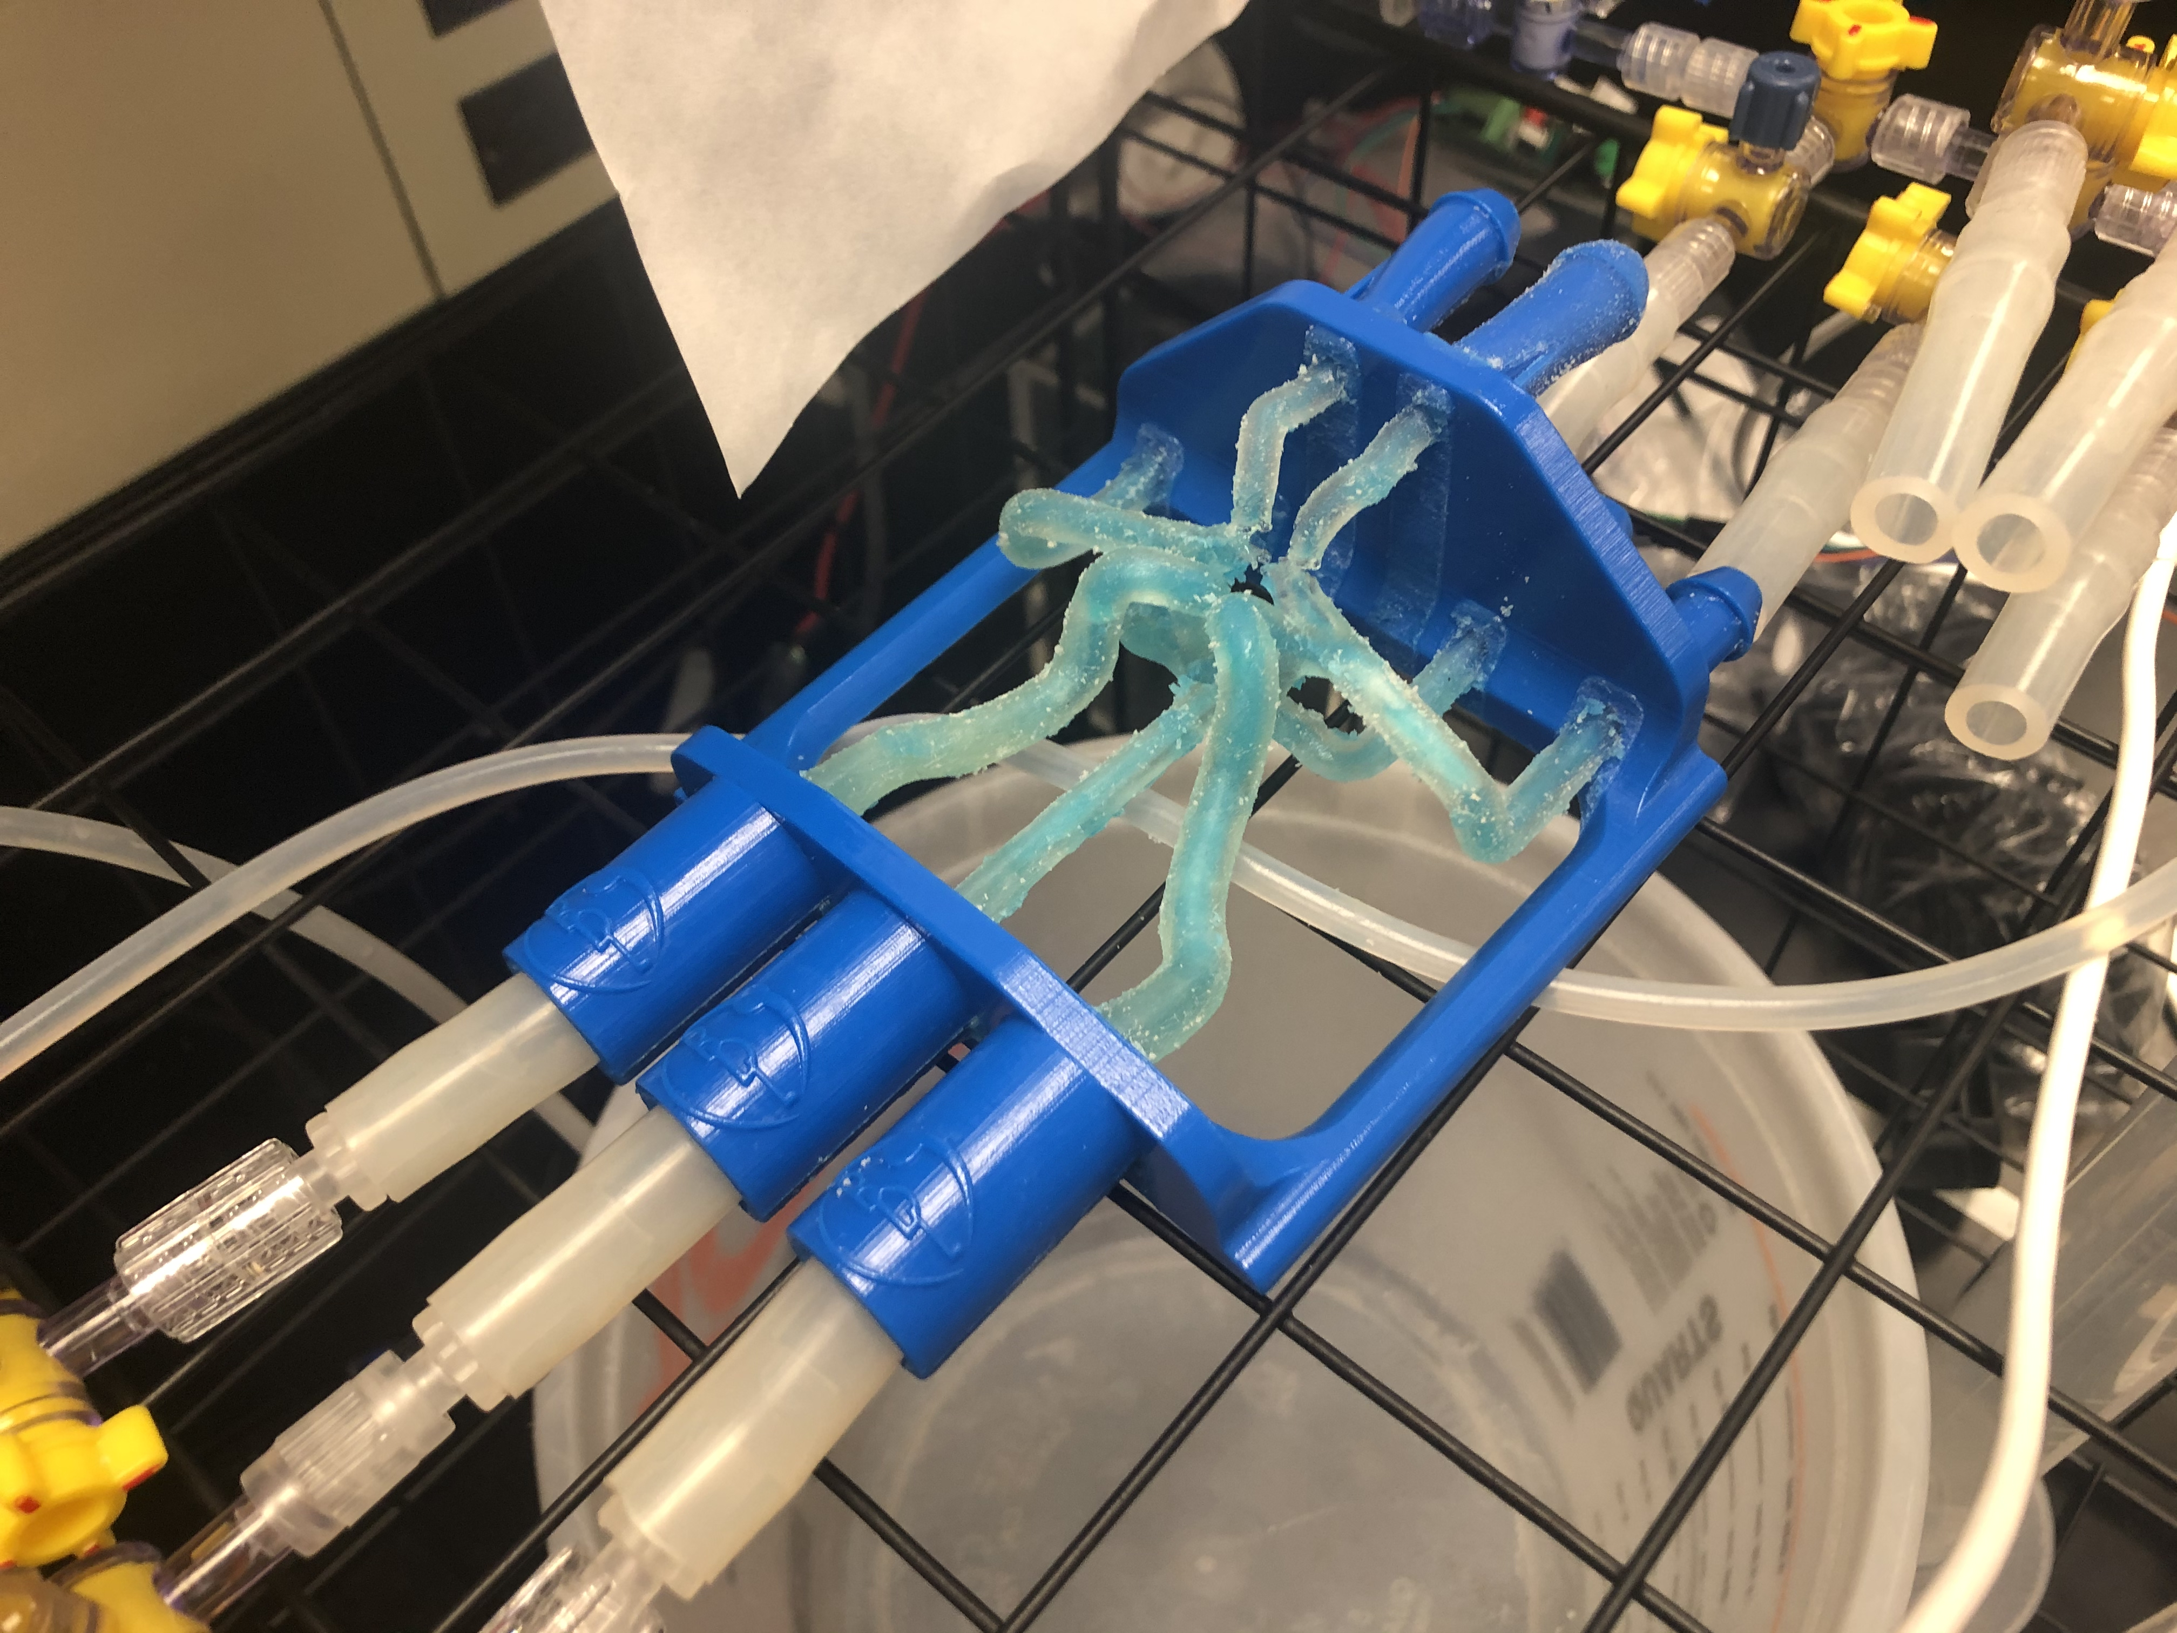
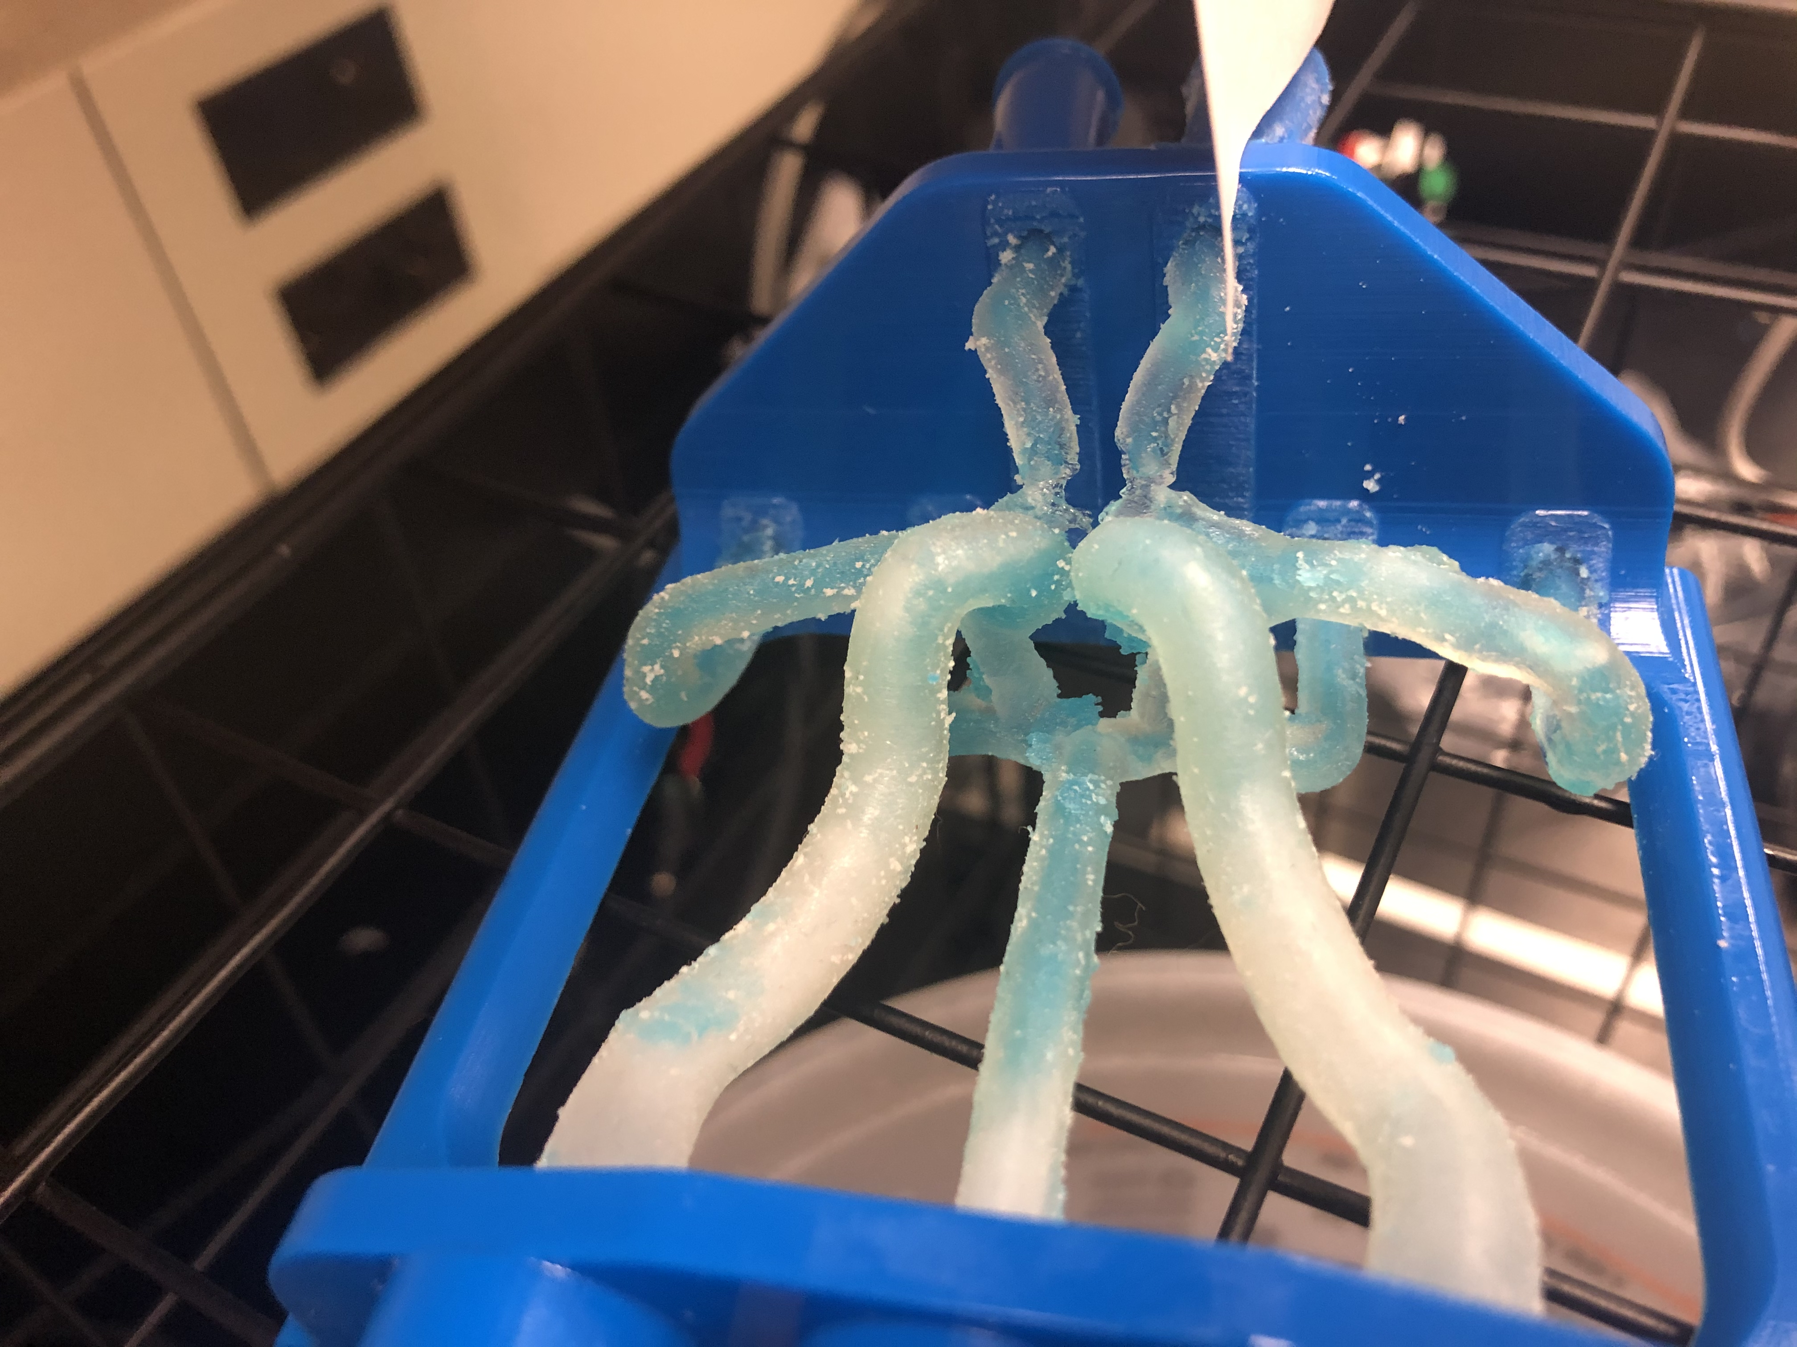
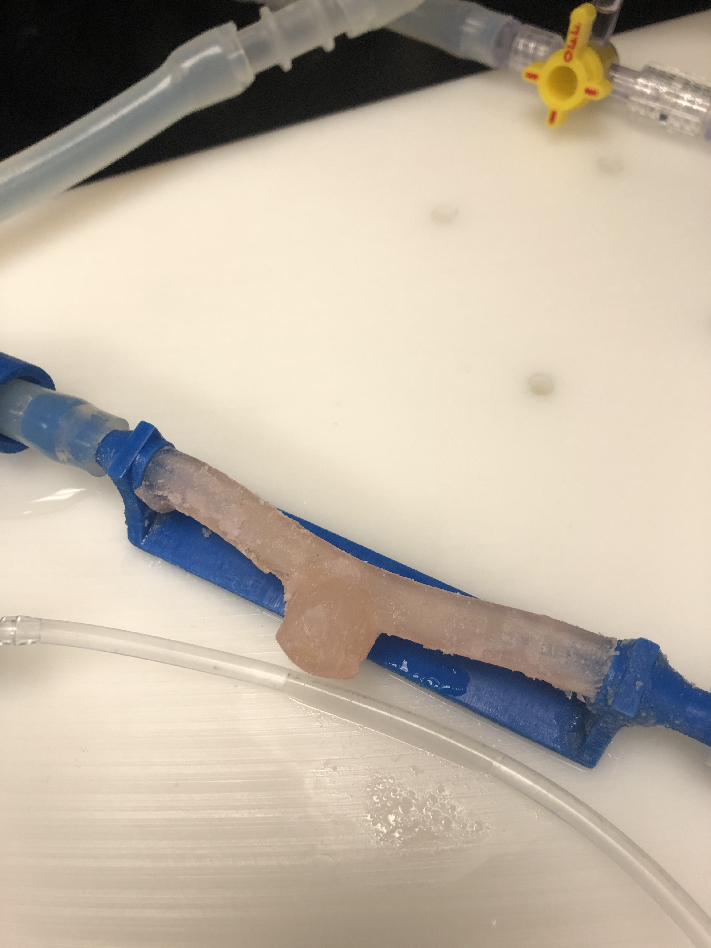
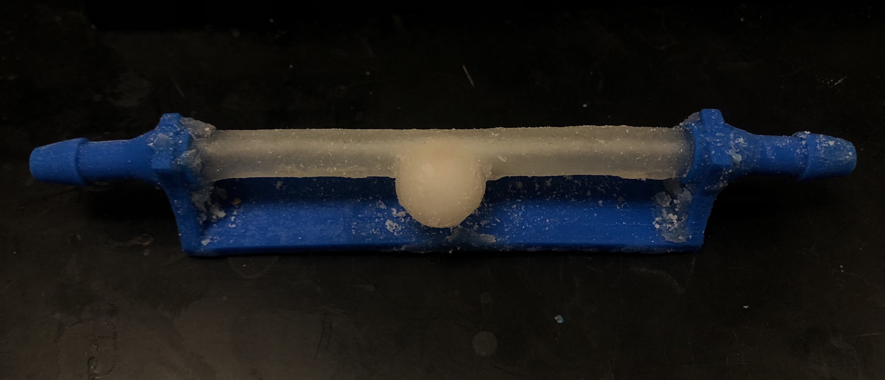
Model Cleaning Time
Sidewalls can currently clean for 2-3 hours*
Circle of Willis models cleans in in 6-8 hours*
*Using Regular Support Material
Figure 1. CW Model; Left: Uncleaned, Right: Partially Cleaned CW
Figure 2. Sidewall Model; Left: Uncleaned, Right: Fully

Slide 8
Future Testing
Differences in Support Material types – Matrix vs. Light
More model cleaning required to conclude minimum model cleaning time

Slide 9
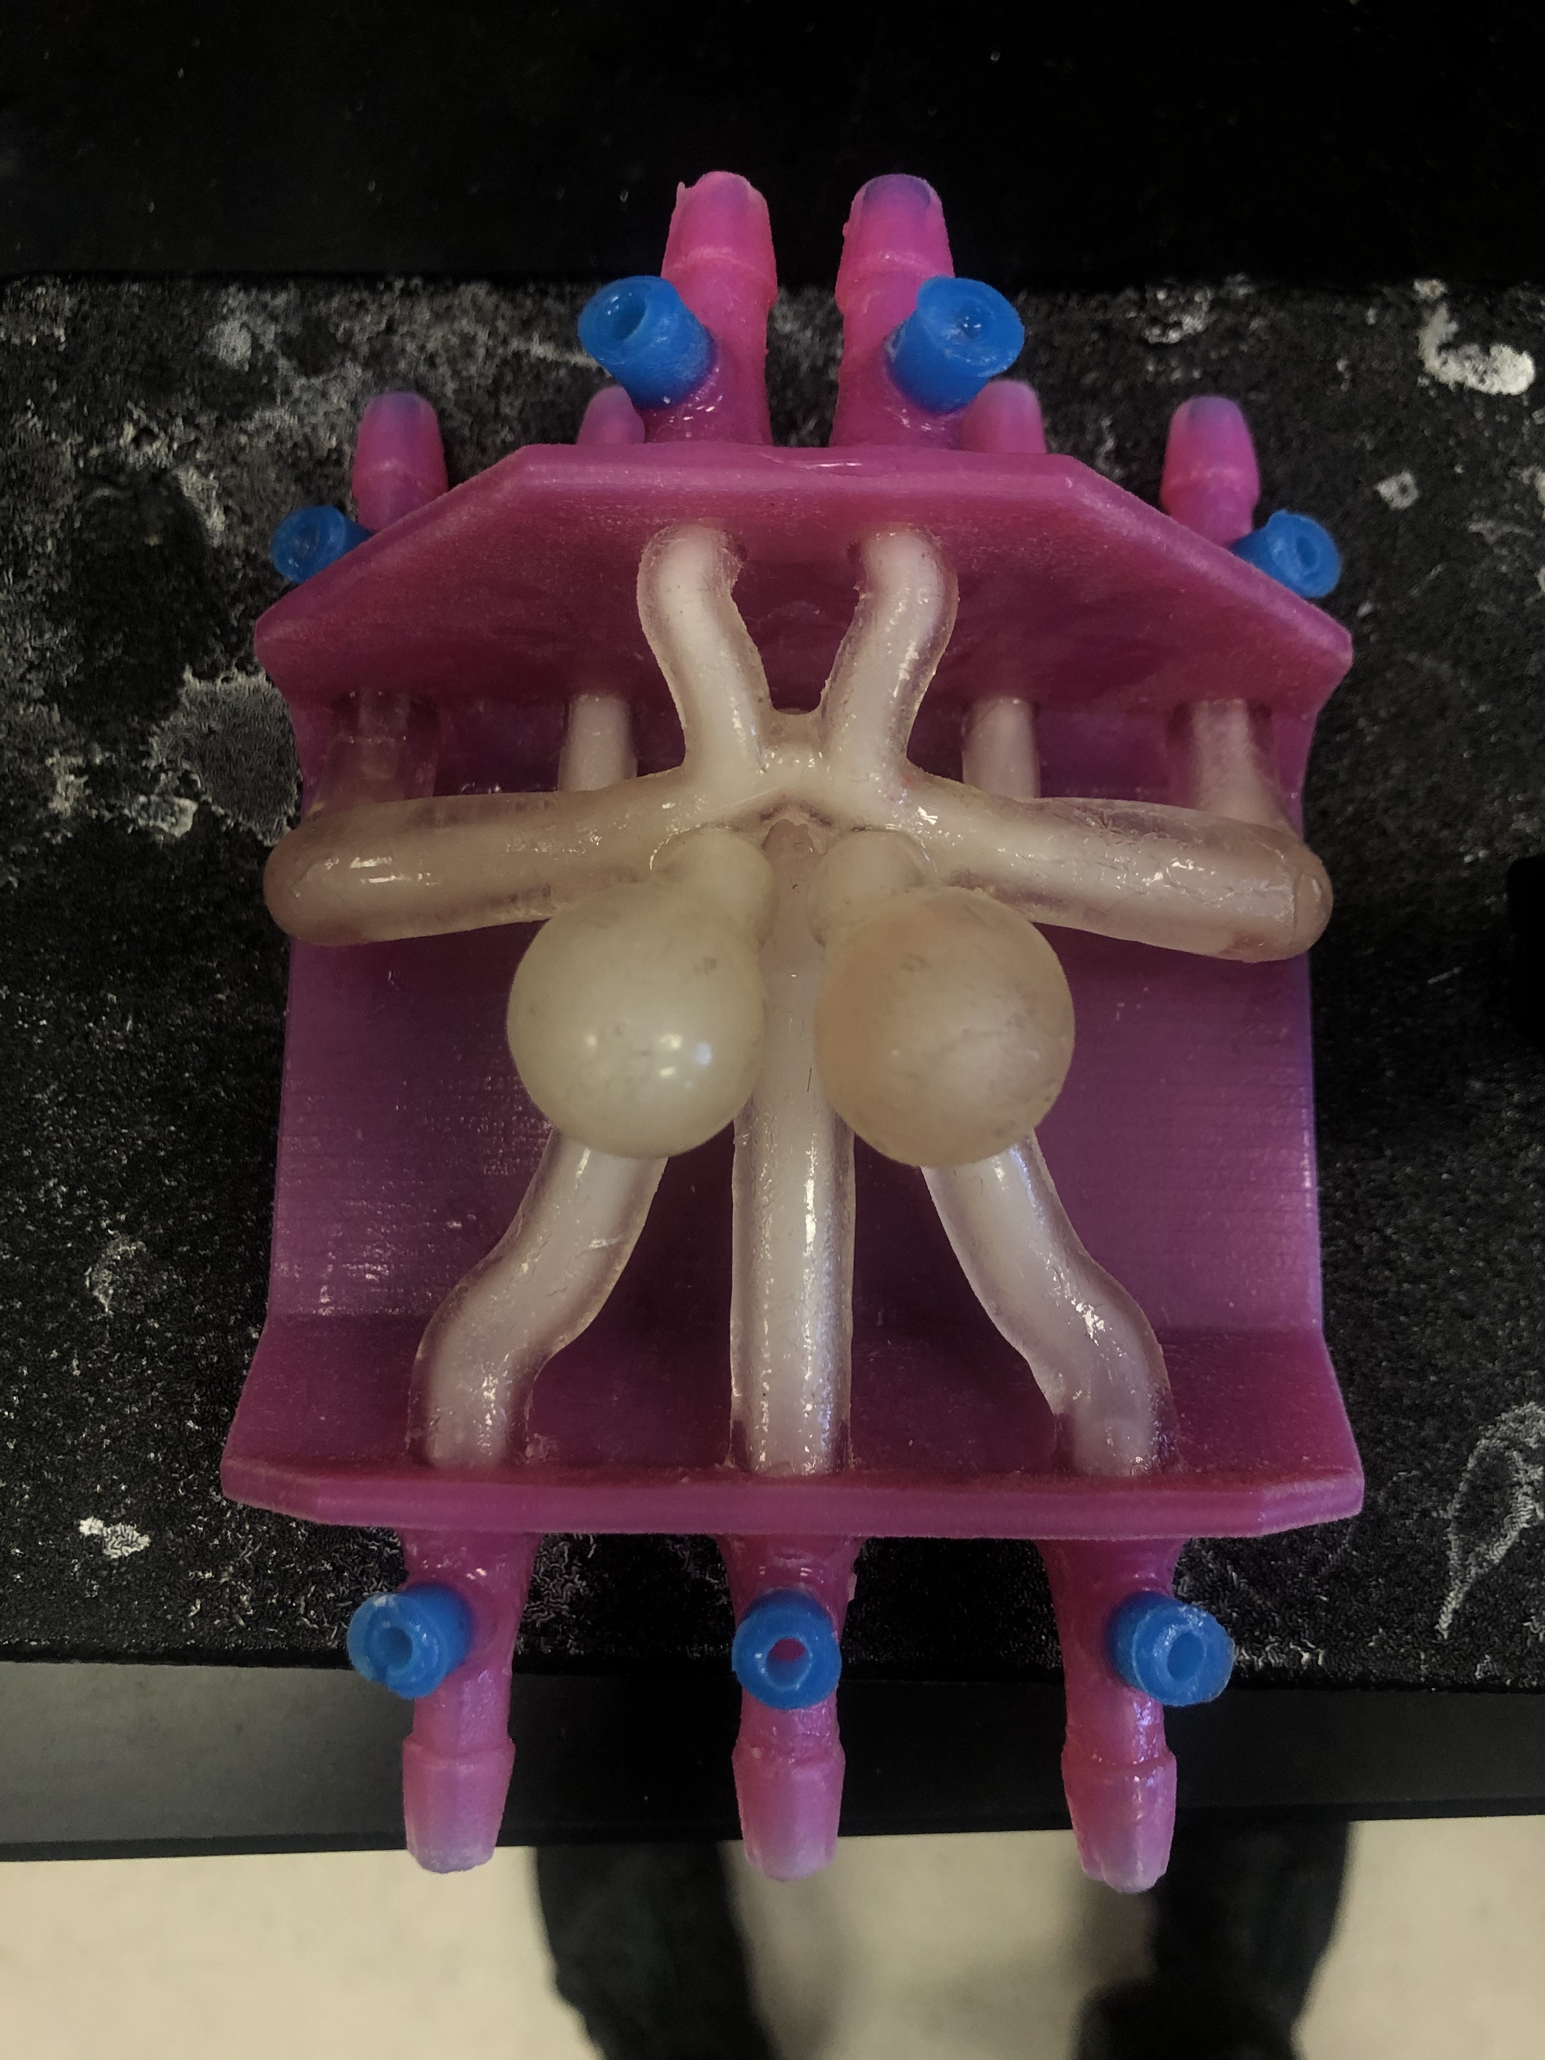
B-Roll
Figure 3. Clean Models; Left: Thick CW w/ Aneurysms, Center: Sidewall w/ Aneurysm, Right: CW w/out Aneurysms

Slide 10
Thank You

